Slide 1




EC2

Slide 2

EC2
Amazon Elastic Compute Cloud (EC2) is a web service that provides resizable compute capacity in the cloud.
It is designed to make web-scale cloud computing easier for developers.
EC2 allows you to launch virtual servers, configure security and networking, and manage storage.

Slide 3
Key Features of AWS EC2
Scalability: Easily scale up or down based on demand.
Flexibility: Wide range of instance types optimized for different use cases.
Cost-Effective: Pay only for the compute time you use.
Security: Integrated with AWS Identity and Access Management (IAM) for secure access.
Reliability: Built on a highly reliable infrastructure.

Slide 4
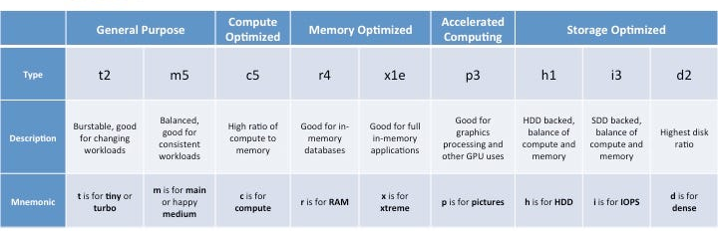
EC2 Instance Types
General Purpose: Balanced compute, memory, and networking resources (e.g., t2, t3).
Compute Optimized: High-performance processors for compute-intensive tasks (e.g., c5, c6g).
Memory Optimized: For memory-intensive applications (e.g., r5, x1).
Storage Optimized: High, sequential read and write access to large datasets (e.g., i3, d2).
Accelerated Computing: Use hardware accelerators, or co-processors, to perform functions such as floating-point number calculations, graphics processing, or data pattern matching (e.g., p3, g4).

Slide 5
EC2 for Machine Learning
GPU Instances: Ideal for training deep learning models (e.g., p3, g4).
High Memory Instances: Suitable for large datasets and in-memory databases (e.g., r5, x1).
Spot Instances: Cost-effective for non-critical workloads, such as model training.
Elasticity: Scale your infrastructure as your ML workloads grow.

Slide 6
EC2 Auto Scaling
Automatic Scaling: Automatically adjust the number of EC2 instances based on demand.
Policies: Define scaling policies to add or remove instances.
Health Checks: Ensure instances are healthy and replace unhealthy ones.
Cost Management: Optimize costs by scaling down during low demand periods.

Slide 7



THANK YOU

